Slide 1


LiDAR Point Cloud Classification
Dan Burke
IST 707
12/8/2021

Slide 2


Outline
What is LiDAR
LiDAR Use cases
LiDAR Point Cloud
Problems
Classification Methods

Slide 3
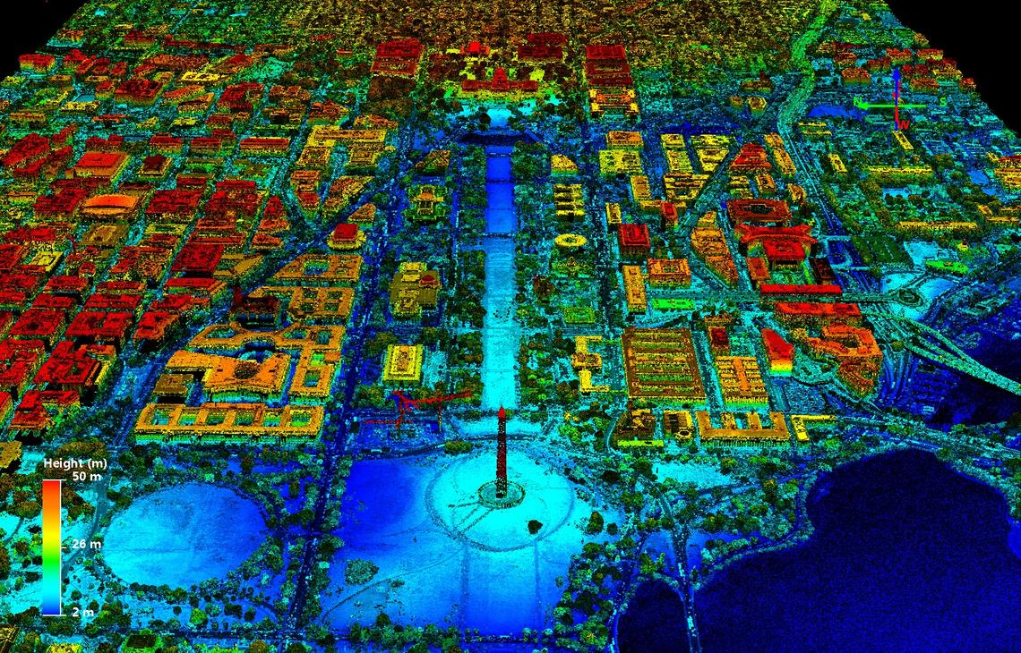
What is LiDAR
Lidar – Light Detection and Ranging
Remote sensing method for examining the surface of the earth or environments
Utilizes light in the form of a “pulsed laser” to measure variable distances.
Outputs three-dimensional data (point cloud)
Lidar point cloud Washington, DC. Lidar Point Cloud Washington, DC. (n.d.). Retrieved December 7, 2021, from https://www.usgs.gov/media/images/lidar-point-cloud-washington-dc-0.

Slide 4
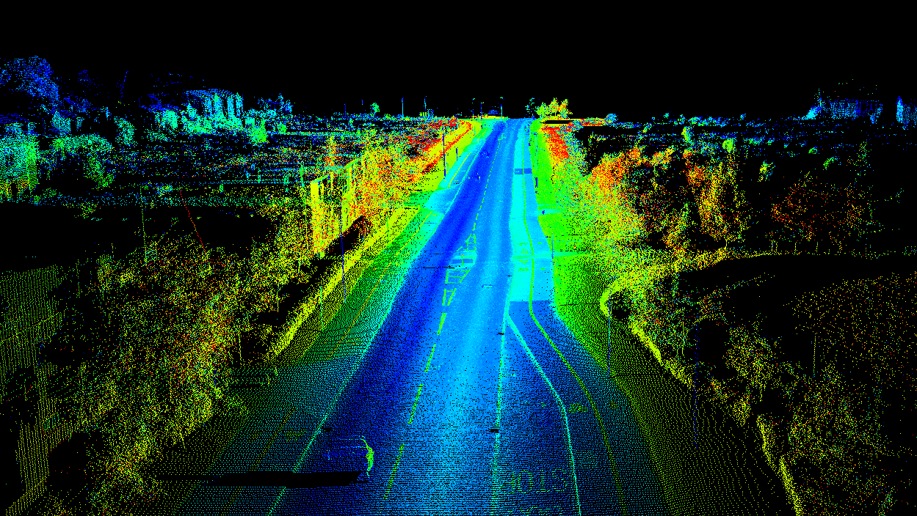
Use Cases
Computer Vision
Surveying
Mapping & Cartography
Terrain Modeling
Bathymetric Mapping
Infrastructure Maintenance
Agriculture & Biology/Conservation
Crop Viability
Crop Categorization
Crop Mapping
Forestry
Gesture Recognition
Autonomous Vehicles
Navigation, Collision Avoidance

Slide 5
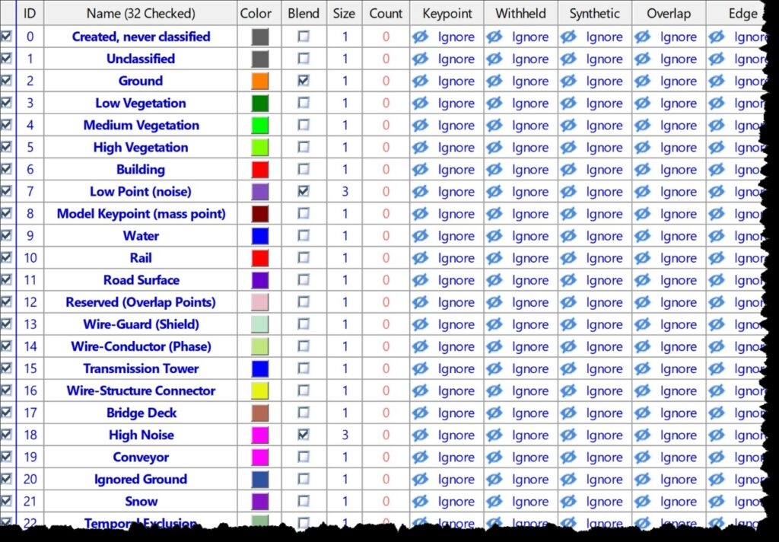
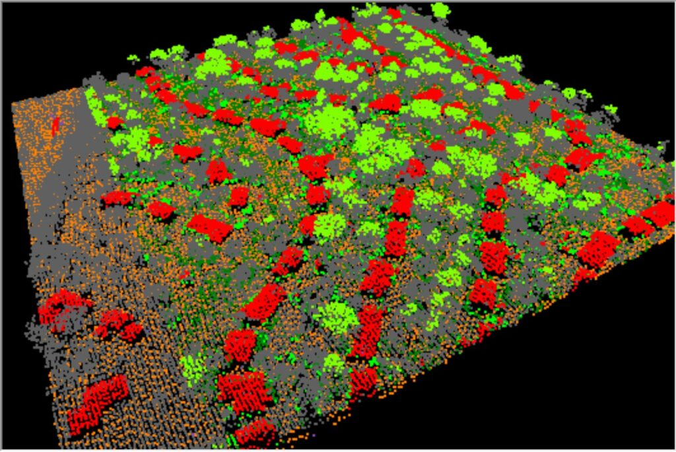
LiDAR Point Cloud
ASPRS Standard Classification
Point Cloud Classification by Color
Notes:
- For many users of LiDAR within engineering or surveying and those who are new to LiDAR as a raw data source, the concept of data classification is novel.
- LiDAR systems send out a pulse of laser light and measure the time until a return echo is detected (like sonar), light travelling through air is nearly constant, hence we are able to range objects.
Additional data such as position, orientation, is collected, this is processed to generate a pseudo-random point cloud in the spatial reference system chosen by the user.
Each point represents a detection
In order to analyze we’ll need to segregate some of the points that we feed into our analysis, selecting enough and the correct points that we want to use to support our model.
Segregating these points is classification, as we are labeling each point according to the “class” of the object. We store this on an individual basis
Typically, this is stored via files formatted for LAS that contains the X, Y, Z attributes and it’s classification.
Object Classification on Point Clouds
- Early attempts to classifying point clouds were developed by adapting ideas from deep learning on images
Difficulty arises from the fact that point clouds do not have a well-defined order of points on which convolutions can be performed, for example photogrammetry.
There are methods of jointly learning point clouds

Slide 6
Problems
Classification of 3D objects has great improvements over the past few years; producing impressive results of approx. 92% accuracy. However, these results have been largely based on CAD data, rather than real world objects.
“Revisiting Point Cloud Classification: A New Benchmark Dataset and Classification Model on Real-World Data” (Uy et al.)
Performed a benchmark of existing point cloud classification techniques, utilizing real-world and synthetic data
ModelNet40 – 10,000 CAD Models
ScanObjectNN
SceneNN
ScanNet
15 Common Categories were manually filtered
Study showed accuracy with CAD data was extremely high “reaching perfection”, however real-world object classification was reduced
Factors that contribute to reduced inaccuracy relate to unavoidable noise and incomplete data (due to sensors)
Notes:
In a study jointly published by Hong Kong University of Science and Technology 2Singapore University of Technology and Design 3The University of Tokyo 4Deakin University
Though GPU’s have increased in in processing power and availability, there remains key problems with point cloud classification
There has been recent research producing high rates of point cloud classification accuracy (approximately 92%) however, problems with 3D object classification have not been entirely solved, most notably classification in the real world, and not running classification on CAD data.

Slide 7

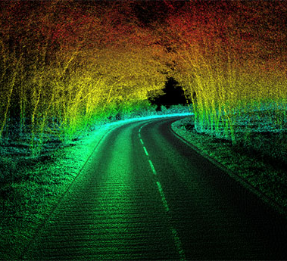
Classification
Methods:
Spatial-Based
Height
Eigenvalue and K-Means
Local Plane
Homogeneity of Surface normal
Surface Roughness
Vertical Profile
Point Density
Density Ratio
Echo-based
Terrain Echo
Vegetation Echo
Power-line Echo
First, intermediate, last return
Wave-form-based (used with full-waveform LiDAR data)
Amplitude, Width, shape and Cross Section
Notes:
K-Means -> The use of the k-means method and exploration of different measures is proposed. K-means is a technique of cluster analysis, which automatically assigns objects to different classes by analyzing the similarities or dissimilarities between them.
The k-means method has been used by some authors to classify LiDAR points, but in different contexts.

Slide 8
References
-, N. D., By, -, News Deskhttp://geospatialmedia.netThis is the account of the Newsdesk team at Geospatial Media. Reach us at newsdesk [@] geospatialmedia.net or call us on +91-120-4612500, Desk, N., & This is the account of the Newsdesk team at Geospatial Media. Reach us at newsdesk [@] geospatialmedia.net or call us on +91-120-4612500. (2018, July 12). LizardTech awarded US patent for Lidar Point Cloud Compression. Geospatial World. Retrieved December 7, 2021, from https://www.geospatialworld.net/news/lizardtech-awarded-us-patent-lidar-point-cloud-compression-2/.
5 compelling applications for LIDAR Technology. Aerial LiDAR & photogrammetry UAV drone survey equipment and software. (n.d.). Retrieved December 7, 2021, from https://www.microdrones.com/en/content/5-compelling-applications-for-lidar-technology/.
Chehata, N., David, N., & Bretar, F. (2008). LIDAR DATA CLASSIFICATION USING HIERARCHICAL K-MEANS CLUSTERING . Retrieved December 7, 2021, from http://citeseerx.ist.psu.edu/viewdoc/download;jsessionid=497E74702B4BB04A37BCC244E1A10B8D?doi=10.1.1.151.1213&rep=rep1&type=pdf.
Cozzens, T. (2020, December 1). Latest OxTS tool combines inertial and LIDAR point-cloud data. GPS World. Retrieved December 8, 2021, from https://www.gpsworld.com/latest-oxts-tool-combines-inertial-and-lidar-point-cloud-data/.
Graham, L. (2021, October 13). What is point cloud classification? GeoCue. Retrieved December 8, 2021, from https://geocue.com/resources/article/what-is-point-cloud-classification/.
Lidar point cloud Washington, DC. Lidar Point Cloud Washington, DC. (n.d.). Retrieved December 7, 2021, from https://www.usgs.gov/media/images/lidar-point-cloud-washington-dc-0.
Thompson, J. (2021, November 12). 100 real-world applications of Lidar Technology. Level Five Supplies. Retrieved December 7, 2021, from https://levelfivesupplies.com/100-real-world-applications-of-lidar-technology/.
US Department of Commerce, N. O. and A. A. (2012, October 1). What is Lidar. NOAA's National Ocean Service. Retrieved December 7, 2021, from https://oceanservice.noaa.gov/facts/lidar.html.
Uy , M., Pham , Q.-H., Hua , B.-S., Nguyen , D. T., & Yeung, S.-K. (2019). Revisiting Point Cloud Classification: A New Benchmark Dataset and Classification Model on Real-World Data. Scanobjectnn. Retrieved December 8, 2021, from https://arxiv.org/pdf/1908.04616.pdf.
Yastikli, N., & Cetin, Z. (2016, December 19). CLASSIFICATION OF LiDAR DATA WITH POINT BASED CLASSIFICATION METHODS . Retrieved December 7, 2021, from https://www.int-arch-photogramm-remote-sens-spatial-inf-sci.net/XLI-B3/441/2016/isprs-archives-XLI-B3-441-2016.pdf.

